Slide 1


Retail Due Date Change Service
API Specification
Innovate
value-focused
digital & data solutions
At Speed.
Harmonize
alignment-focused organizational functions
At Scale.
Execute
customer-focused experiential services
With Confidence.

Slide 2

Enterprise Service Platform (ESP)
Retail Due Date Change Service – API Specification

Slide 3
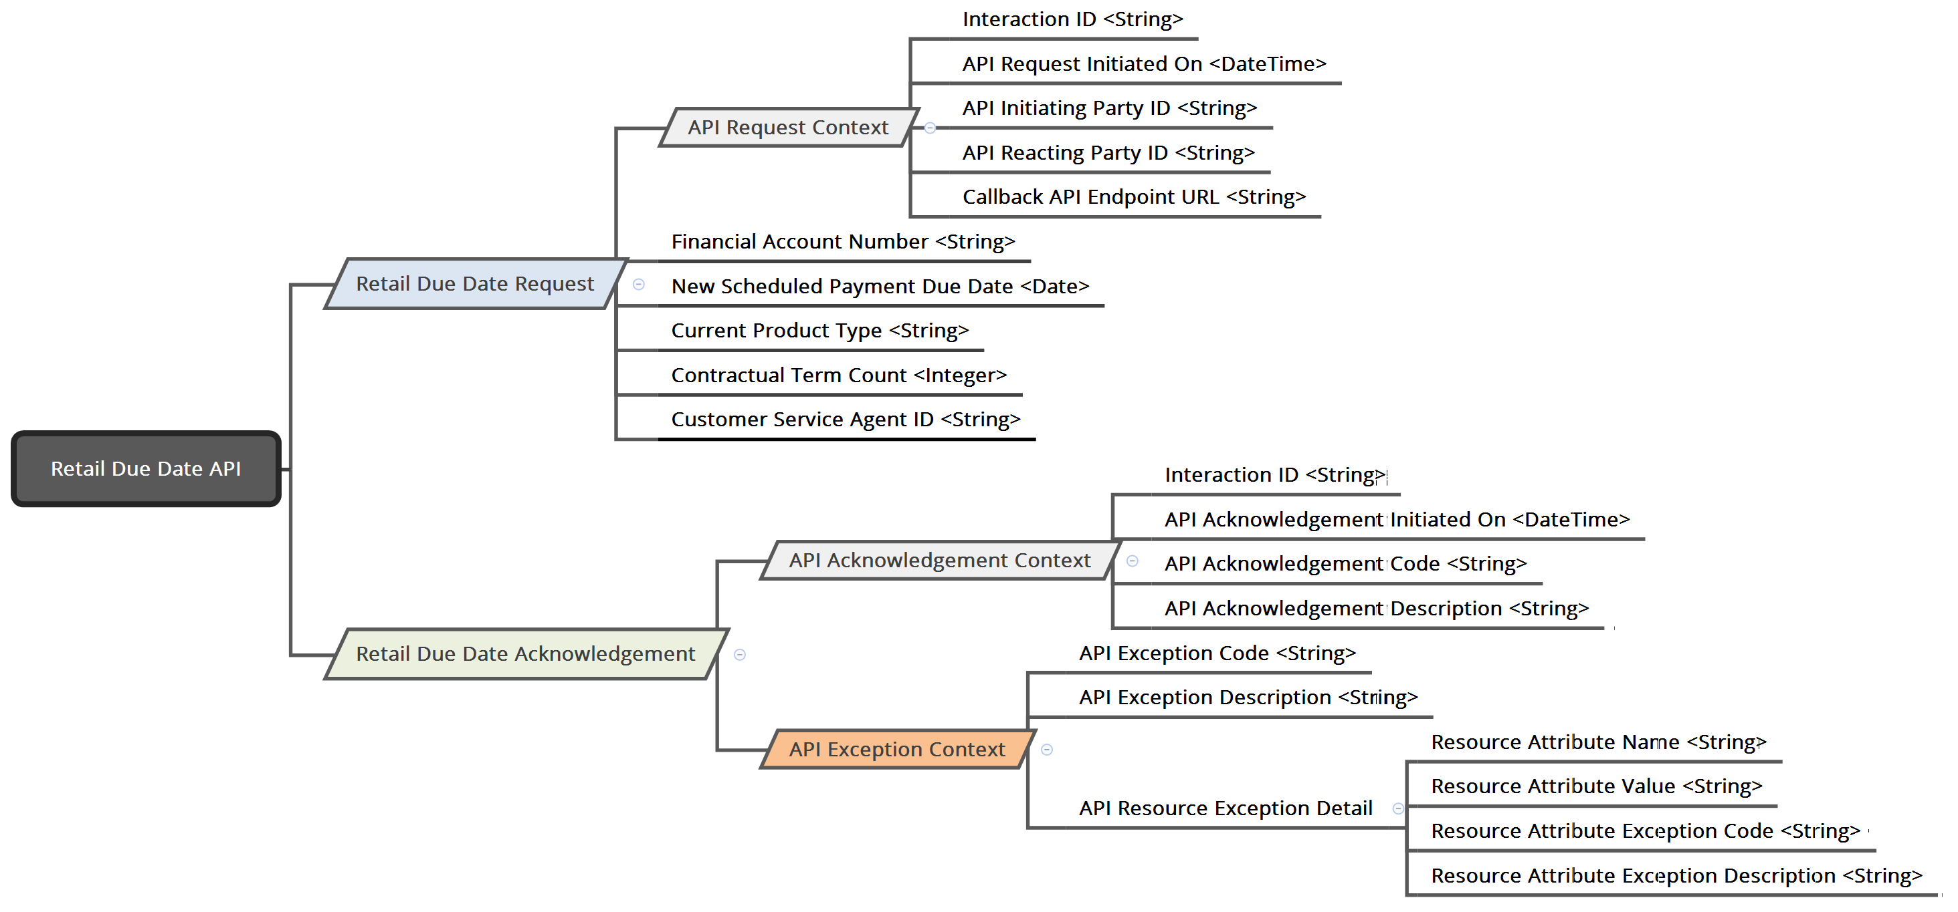
Retail Due Date Change Service : ‘API Specification’ – Version 0.1

Slide 4
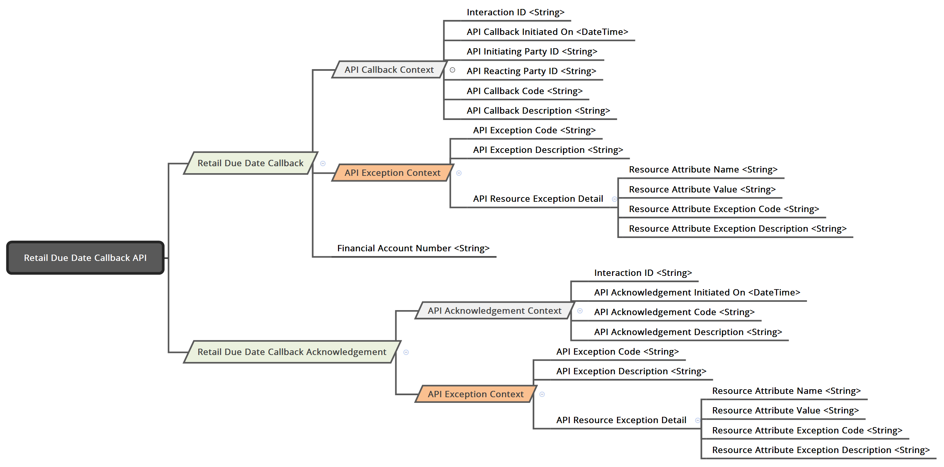
Retail Due Date Change Service : ‘Callback API Specification’ – Version 0.1

Slide 5
Retail Due Date Change Service: Information Element Specification
Information Item:
Financial Account Number *
Optionality:
Required
Description:
Financial Account Number is the unique identifier of a Retail Loan Account within CEP.
Behavior:
Retail Financial Account Number is a composite Key that comprises of: Branch & Customer Loan Number
[Branch][Customer Loan Number]
[999][AAAAAAA]
Client Behavior:
Client must always provide Retail Financial Account Number for the given Due Date Change transaction.
Service Behavior:
Service must validate the existence of Financial Account Number in the Retail System.
Service must extract Branch & Customer Loan Number from Financial Account Number to invoke Retail Due Date Change API on zOSConnect.
Service must process the Due Date Change transaction in the Retail System for the given Retail Financial Account Number.
Input:
Yes
Output:
No
Data Type:
String
Format:
[999][AAAAAAA]
Default:

Slide 6
Retail Due Date Change Service: Information Element Specification
Information Item:
New Scheduled Payment Due Date *
Optionality:
Required
Description:
New Scheduled Payment Due Date is the new due date requested by Retail Customer to make the contractually obligated scheduled payments for future billing cycle(s).
Behavior:
Client Behavior:
Client must always provide the New Scheduled Payment Due Date for the given Due Date Change transaction.
Service Behavior:
Service must process the Due Date Change transaction in the Retail System with the given New Scheduled Payment Due Date.
Input:
Yes
Output:
No
Data Type:
String
Format:
YYYY-MM-DD
Default:

Slide 7
Retail Due Date Change Service: Information Element Specification
Information Item:
Current Product Type *
Optionality:
Required
Description:
Current Product Type indicates the type of Interest Loan to differentiate between Simple Interest & Balloon Interest Loan Accounts.
Behavior:
Client Behavior:
Client must always provide the value of Balloon Indicator flag to identify “Simple Interest” vs “ Balloon” Account.
Service Behavior:
Service must process the Due Date Change transaction in the Retail System with the given New Scheduled Payment Due Date.
Enumeration Values:
R - Retail Simple Interest Account
B - Retail Balloon Account
Input:
Yes
Output:
No
Data Type:
String Enumeration
Format:
Default:

Slide 8
Retail Due Date Change Service: Information Element Specification
Information Item:
Contractual Term Count *
Optionality:
Required
Description:
Contractual Term Count is the Original Term Count recorded in Loan Origination System at the time Booking the Loan.
Behavior:
Client Behavior:
Client must always provide the Original Contract Term Count from Carlos.
Service Behavior:
Service must Check “Contractual Term Count” = Sum (Number of Payments across all Payment Schedules) retrieved from ILNS
Matches: Service must use “Contractual Term Count” to derive “Number of Payments” for the New Payment Schedule in ILMX
Does Not Match: Service must return Exception in API Callback with Error Code. Account must be processed manually by CSC Agent.
Input:
Yes
Output:
No
Data Type:
Integer
Format:
Default:

Slide 9
Retail Due Date Change Service: Information Element Specification
Information Item:
Customer Service Agent ID *
Optionality:
Required
Description:
Customer Service Agent ID is the ID of the Customer Service User who initiated due date change request for the retail customer account on the Client System.
Behavior:
Client Behavior:
Client must always provide the Customer Service Agent ID of the User who initiated the due date change request.
Service Behavior:
Service must record Customer Service Agent ID information for audit and logging purposes.
Input:
Yes
Output:
No
Data Type:
String
Format:
Default:

Slide 10
Retail Due Date Change Service: Information Element Specification
Information Item:
API Request Context *
Optionality:
Required
Description:
API Request Context provides the detailed context of the specific instance of API Request from Client for processing Due Date Change transaction.
Behavior:
API Request Context captures the following information:
Interaction ID - Globally Unique Identifier assigned by Client System representing the instance of an interaction with the Due Date Change Service, used to correlate the Client-Service Interaction.
API Callback Initiated On - Date & Time at which API Request was Initiated by Client in ISO 8601 format.
API Initiating Party ID - Unique Identifier representing the Party/System Initiating the API.
API Reacting Party ID - Unique Identifier representing the Party/System Reacting to the API.
Callback API Endpoint URL - Fully Qualified Enpoint URL with Resource Path for Asynchronous Response Callback from Due Date Change Service
Client Behavior:
Client must provide the API Request Context when invoking Due Date Change API.
Service Behavior:
Service must Log the API Request Context information for Auditing & Monitoring purpose.
Input:
No
Output:
Yes - Optional
Data Type:
Object
Format:
Default:

Slide 11
Retail Due Date Change Service: Information Element Specification
Information Item:
API Acknowledgement Context *
Optionality:
Required
Description:
API Acknowledgement Context provides the detailed context of the Receipt Acknowledgement from Service to Client confirming the receipt of API Request from Client for Due Date Change transaction.
Behavior:
API Acknowledgement Context captures the following information:
Interaction ID - Globally Unique Identifier assigned by Client System representing the instance of an interaction with the Due Date Change Service, used to correlate the Client-Service Interaction.
API Acknowledgement Initiated On - Date & Time at which API Acknowledgement was Initiated by Due Date Change Service in ISO 8601 format.
API Acknowledgement Code - Return code from the Due Date Change Service indicating that the Due Date Change transaction was enqueued successfully for asynchronous processing.
API Acknowledgement Description - Provides the description for Return Code from the Due Date Change Service indicating that the Due Date Change transaction was enqueued successfully for future processing.
Client Behavior:
Client must log the API Acknowledgement Context information for Audting & Monitoring purpose.
Service Behavior:
Service must provide the API Acknowledgement Context information when acknowledging Client API Request.
Note:
Use appropriate HTTP status codes in “API Acknowledgement Code“ as applicable and keep it agnostic of the transport protocol.
API Acknowledgement Code : 202 – “Due Date Change Transaction Request Accepted & Enqueued for Asynchronous Processing”
API Acknowledgement Code : 400 – “Invalid Request, Structural Validation Failed”
Input:
No
Output:
Yes - Optional
Data Type:
Object
Format:
Default:

Slide 12
Retail Due Date Change Service: Information Element Specification
Information Item:
API Exception Context +
Optionality:
Description:
API Exception Context provides the detailed context to the Exception Occurred in processing the Due Date Change transaction.
Behavior:
API Exception Context captures the following information:
API Exception Code - Exception code from the Due Date Change Service indicating that the Due Date Change transaction was not processed successfully.
API Exception Description - Provides the description for Exception Code from the Due Date Change Service indicating that the Due Date Change transaction was not processed successfully
API Resource Exception Detail: Array of references to the Resource Attribute that caused the Exception
Resource Attribute Name - Name of the Resource Attribute that cased the Exception.
Resource Attribute Value - Value of the Resource Attribute that cased the Exception.
Resource Attribute Exception Code - Exception Code representing the type of error caused by the given Resource Attribute.
Resource Attribute Exception Description - Description of the Exception Code representing the type of error caused by the given Resource Attribute.
Client Behavior:
Client can use API Exception Context to analyze & debug the problem in processing Due Date Change transaction.
Service Behavior:
Service can use API Exception Context to analyze & debug the problem in processing Due Date Change transaction.
Input:
No
Output:
Yes - Optional
Data Type:
Object
Format:
Default:

Slide 13
Retail Due Date Change Service: Information Element Specification
Information Item:
API Callback Context *
Optionality:
Required
Description:
API Callback Context provides the detailed context of the Callback Response from Service for the specific instance of API Request from Client for processing Due Date Change transaction.
Behavior:
API Callback Context captures the following information:
Interaction ID - Globally Unique Identifier assigned by Client System representing the instance of an interaction with the Due Date Change Service, used to correlate the Client-Service Interaction.
API Callback Initiated On - Date & Time at which Callback API was Initiated by Server in ISO 8601 format.
API Initiating Party ID - Unique Identifier representing the Party/System Initiating the API.
API Reacting Party ID - Unique Identifier representing the Party/System Reacting to the API.
API Callback Code - Response Code from the Due Date Change Service indicating the status of Due Date Change transaction.
API Callback Description - Provides the description for Response Code from the Due Date Change Service indicating the status of Due Date Change transaction
Client Behavior:
Client must log the API Callback Context information for Audting & Monitoring purpose.
Service Behavior:
Service must provide the API Callback Context information when invoking Due Date Change Callback API
Note:
Use appropriate HTTP status codes in “API Callback Code” as applicable and keep it agnostic of the transport protocol.
API Callback Code: 200 – “Due Date Change Transaction Request Processed Successfully”
API Callback Code: 503 – “Due Date Change Transaction Initial Attempt Failed, Enqueued for Retry”
API Callback Code: 500 – “Error processing Due Date Change Transaction Request”
Service should report “Retry Processing” thru Callback API.
Input:
No
Output:
Yes - Optional
Data Type:
Object
Format:
Default:

Slide 14

Copyright © 2012-2017 Steerwise Inc. All Rights Reserved.
Steerwise Inc. disclaims all warranties with regard to this material and contents herein, including all implied warranties of suitability and fitness for any particular purpose. In no event shall Steerwise Inc. be liable for any special, incidental, indirect or consequential damages or any damages whatsoever resulting from loss of use, data or profits, whether in an action of contract, negligence or other tortious action, arising out of or in connection with the use or inability to use this material or performance of this material.
All or specific content in this material is protected by copyright, and permission must be obtained from the owner prior to any prohibited reproduction, storage in a retrieval system, or transmission in any form or by any means, electronic, mechanical, photocopying, recording or likewise. No one is allowed to remove or modify proprietary markings or legends, logos, trademarks, trade secrets, copyright and rights notices from this material under any circumstances.
This copyrighted material is intended for use by the licensed customers only. None of the information found here can be used for commercial gain of any kind including resale or reproduction for profit. No one is allowed to copy or sell or distribute any of the material or contents thereof or any derivate works to any party as their own, or of any other party, without explicitly obtaining either a commercial or non-commercial license from Steerwise Inc.
Business Technology Architecture® is a registered trademark of Steerwise Inc. Business Value First™, Innowise™, Alignwise™, Performwise™, Meaning-Oriented-Modeling™, Meaning-Oriented-Integration™, Business Being™, Data Efficacy & Data Excellence™ are trademarks of Steerwise Inc.
Any inquiries regarding this material, requests for usage rights for the material or contents included herein, should be sent by email to info@steerwise.com

